Slide 1
Statistical Validation of a Novel Porosity Segmentation Algorithm Within Ceramic Matrix Composites (CMCs)
Nik Benko and Peter Creveling
Department of Mechanical Engineering
MEEN 6035
Notes:
Hello everyone and thank you for coming to my talk today. My name is Peter Creveling and I’m currently a PhD candidate from the University of Utah working in the Utah composites Lab.
The title of my research talk today is “Imaging…”

Slide 2
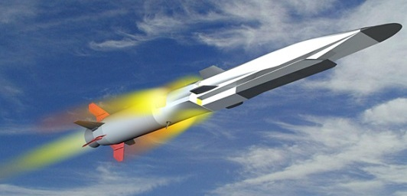

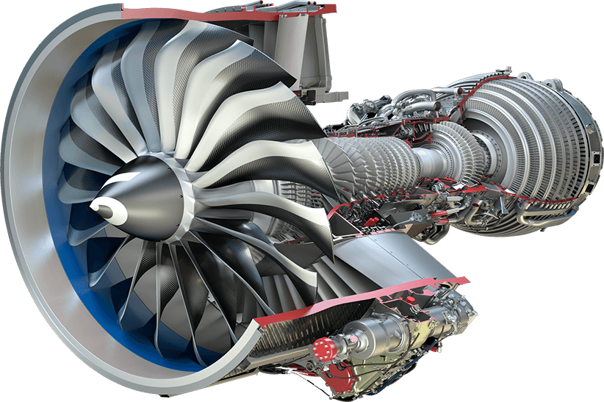

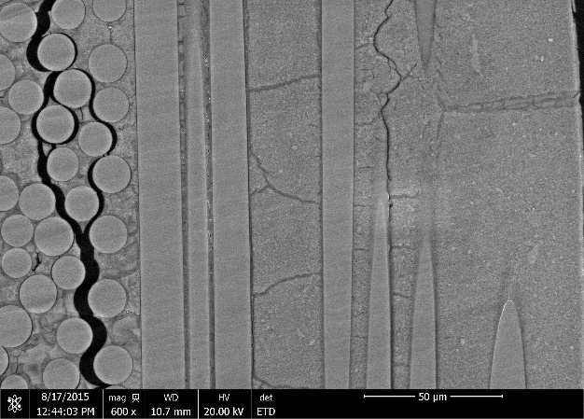
Background
CMCs exhibit excellent performance in extreme thermo-mechanical-oxidative environments
Prediction of damage in CMCs remains a significant challenge
Objective: Use high-resolution X-ray micro-tomography (μCT) and in situ testing to image and study the entire life-cycle of CMCs.
USAF X-51A Waverider
Source: USAF
GE LEAP engine
Source: GE Aviation
50 μm
SiC/SiC composite
Source: D. Marshall, Teledyne

Slide 3
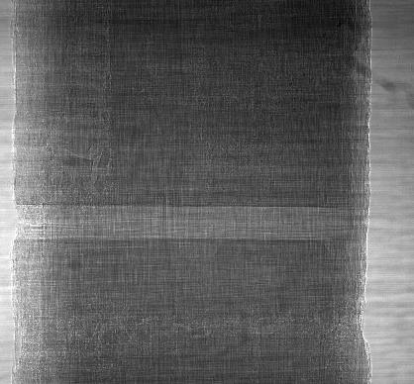
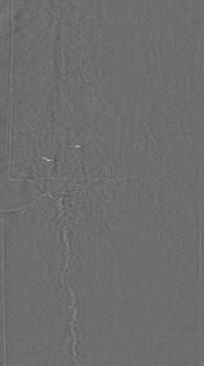
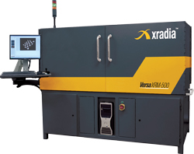

X-ray microcomputed tomography (μCT)
Attenuation images
Tomographic images
What is X-ray μCT?
Generation of individual image slices (tomographs) from attenuated X-ray images (sinograms)
Xradia Carl Zeiss Versa XRM-520
∼400 nm – 3μm resolution range
AFRL

Slide 4
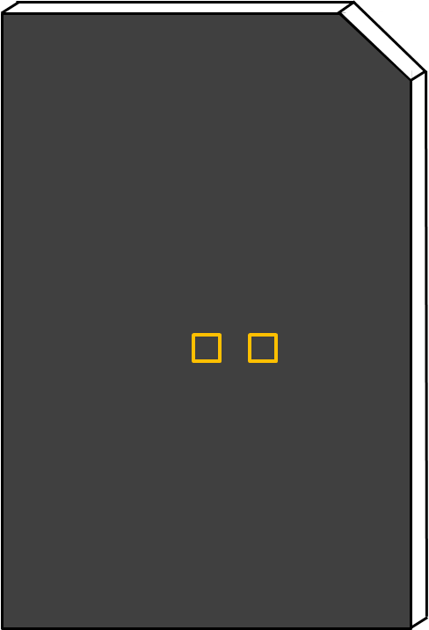
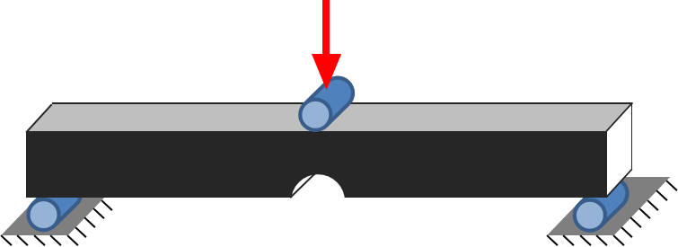

Materials and approach
Material system:
CG Nicalon 8HS satin weave fabric
SMP-10 matrix
Fabrication:
[0/90]_{2s} stacking sequence
60 x 30 x 1.5 mm plate
Polymer infiltration and pyrolysis (PIP)
Pyrolysis is performed at 1000°C
Experimental approach:
Use AFRL’s Xradia XRM-520 μCT system to image evolution of the microstructure during the PIP process
Perform in situ mechanical testing in realistic conditions (1000°C in humid air)
2.5 mm
60 mm
5 mm
2.5 mm
2.5 mm
30 mm
1.5 mm
P
P
P

Slide 5
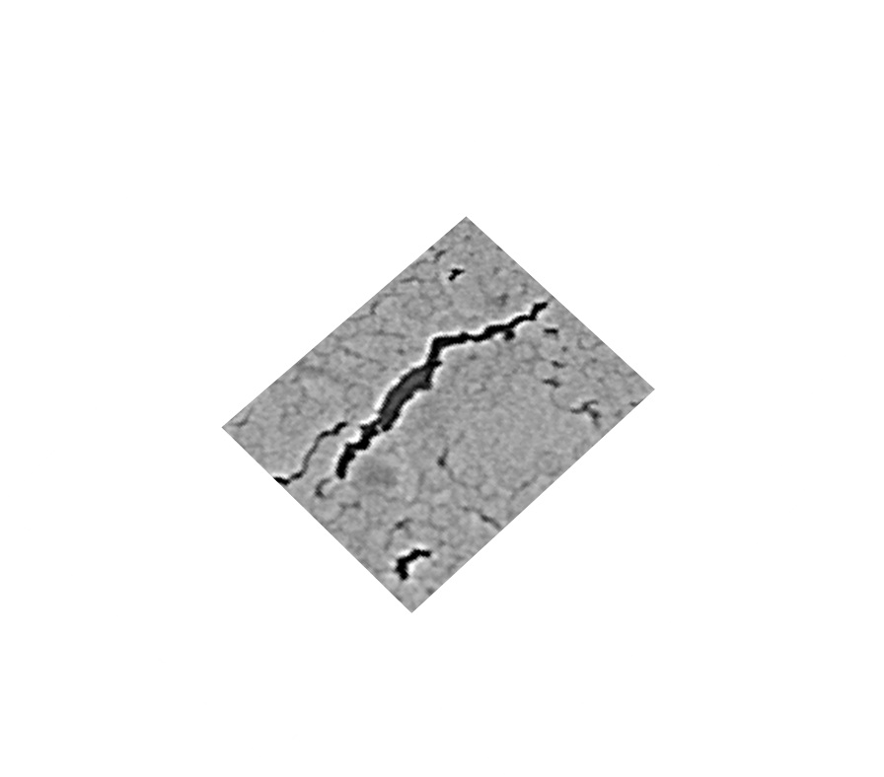
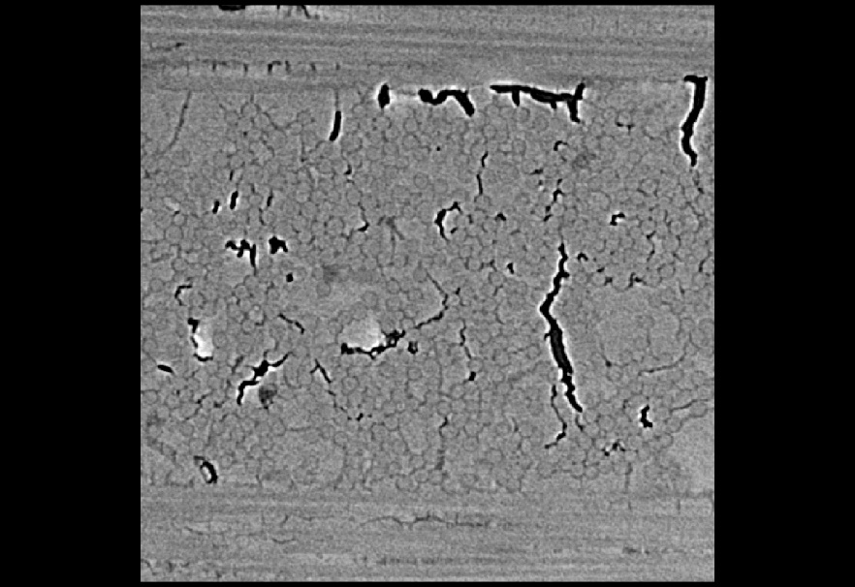
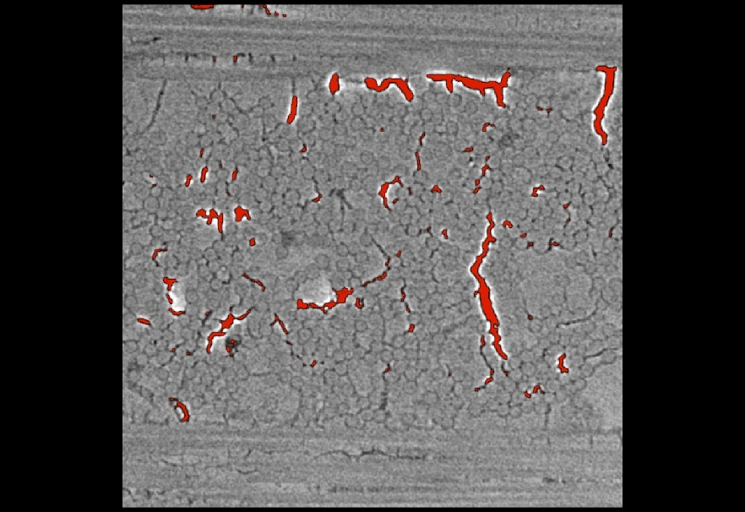

Image data and segmentation
Image data:
 | Scan time (hrs.) | # of images | Resolution (mm/voxel) | Data size (GB)
Versa 520 | 37.3 | 1980 8-bit | 1.21 | 22.1
Segmentation:
Classify sections of pixels corresponding to individual fibers, cracks, and voids
No automatic method to segment data
Gray-scale thresholding:
Dependent on contrast between neighboring pixels
Performed manually

Slide 6
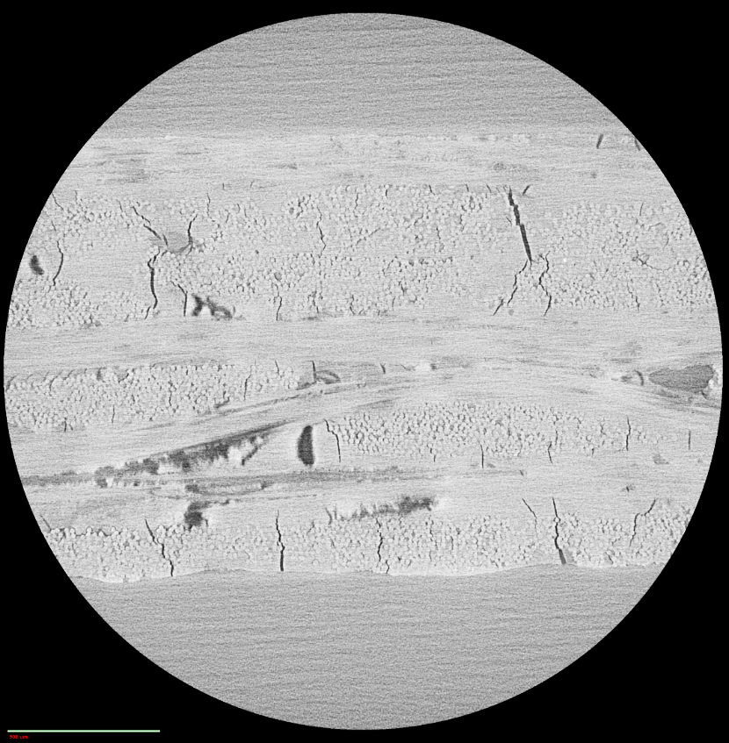
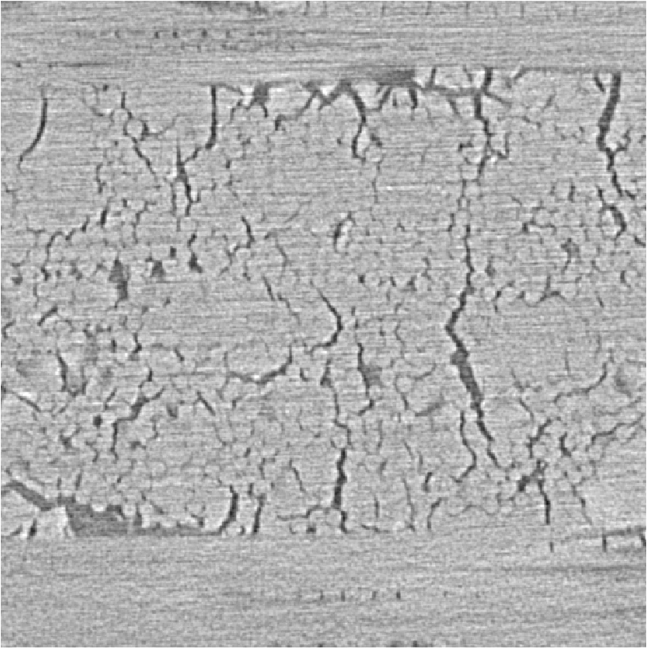
Motivation
0° fiber tow
Challenge:
Accurate segmentation (extraction) of physical features within the microstructure
Efficient means for segmentation compared to manual methods
Objective:
Develop an algorithm to accurately and efficiently segment porosity from images collected via X-ray CT
90° fiber tow
Shrinkage cracks
Void
Zoomed in view of the material microstructure

Slide 7
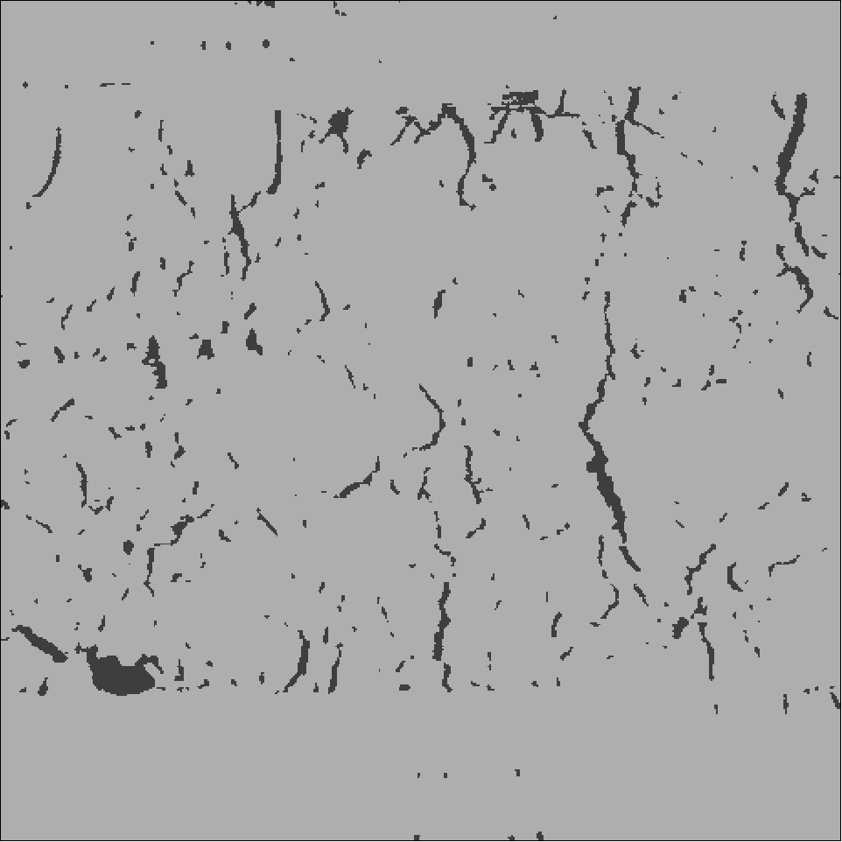
Image data
Sub-volume region of interest (ROI):
500 x 500 x 500 pixels
Treatment:
Manual vs. automatic segmentation
Observation variable:
Porosity
Cross-section of the microstructure
Automatic segmentation:
Pre-processing using a non-local-means filter
WEKA segmentation in 2-D and 3-D
Edge Erosion correction
Manual segmentation of porosity

Slide 8
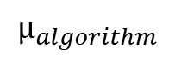
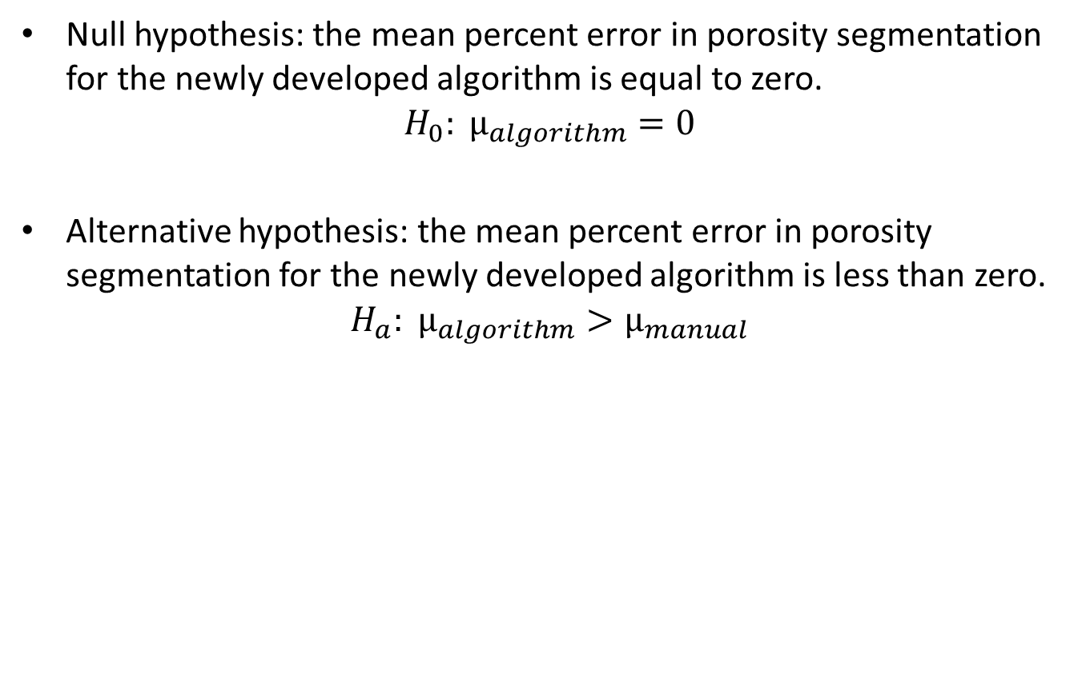

Hypothesis
Null hypothesis: the mean percent error in porosity segmentation for the newly developed algorithm is equal to zero.
$$H_{0}: µ_{algorithm}=0$$
Alternative hypothesis: the mean percent error in porosity segmentation for the newly developed algorithm is less than zero.
$$H_{a}: µ_{algorithm}>µ_{manual}$$
$$0$$
$$µ_{algorithm}$$

Slide 9
Power calculation
Based on your null and alternative hypotheses calculate the power of your DoE.
List any assumptions that you make.
Briefly describe, based on your resulting power and assumptions, either:
how confident you were to move forwards and conduct the analysis
OR
How this power calculation made you alter your hypotheses

Slide 10
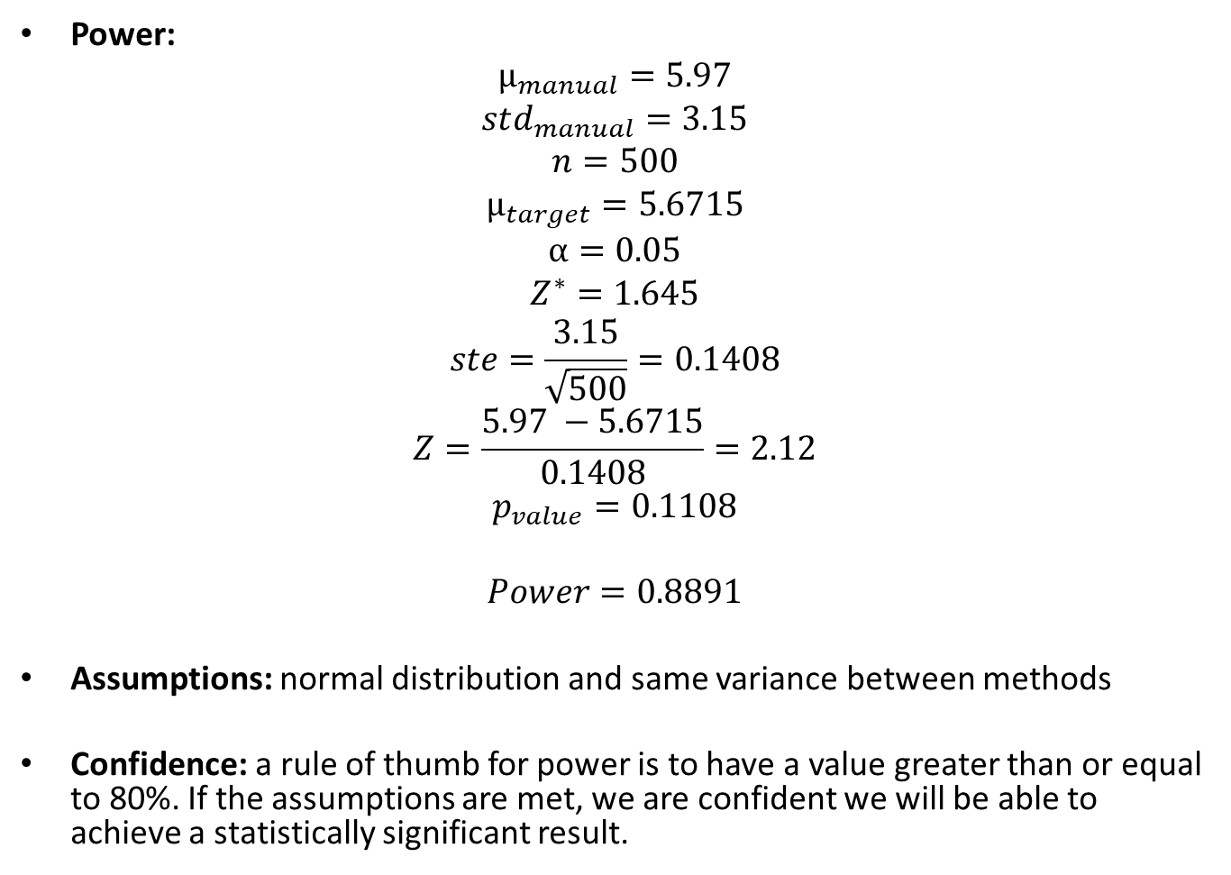
Power calculation
Power:
$$µ_{manual}=5.97$$
$$std_{manual}=3.15$$
$$n=500$$
$$µ_{target}=5.6715$$
$$α=0.05$$
$$Z^{∗}=1.645$$
$$ste=\frac{3.15}{\sqrt{500}}=0.1408$$
$$Z=\frac{5.97 −5.6715}{0.1408}=2.12$$
$$p_{value}=0.1108$$
$$Power=0.8891$$
Assumptions: normal distribution and same variance between methods
Confidence: a rule of thumb for power is to have a value greater than or equal to 80%. If the assumptions are met, we are confident we will be able to achieve a statistically significant result.

Slide 11
Statistical analysis
Describe the statistical analyses that you used in your DoE project.
For each statistical analysis used, provide a short explanation (one spoken sentence) of why you chose that analysis/why that analysis is appropriate for your purposes.

Slide 12
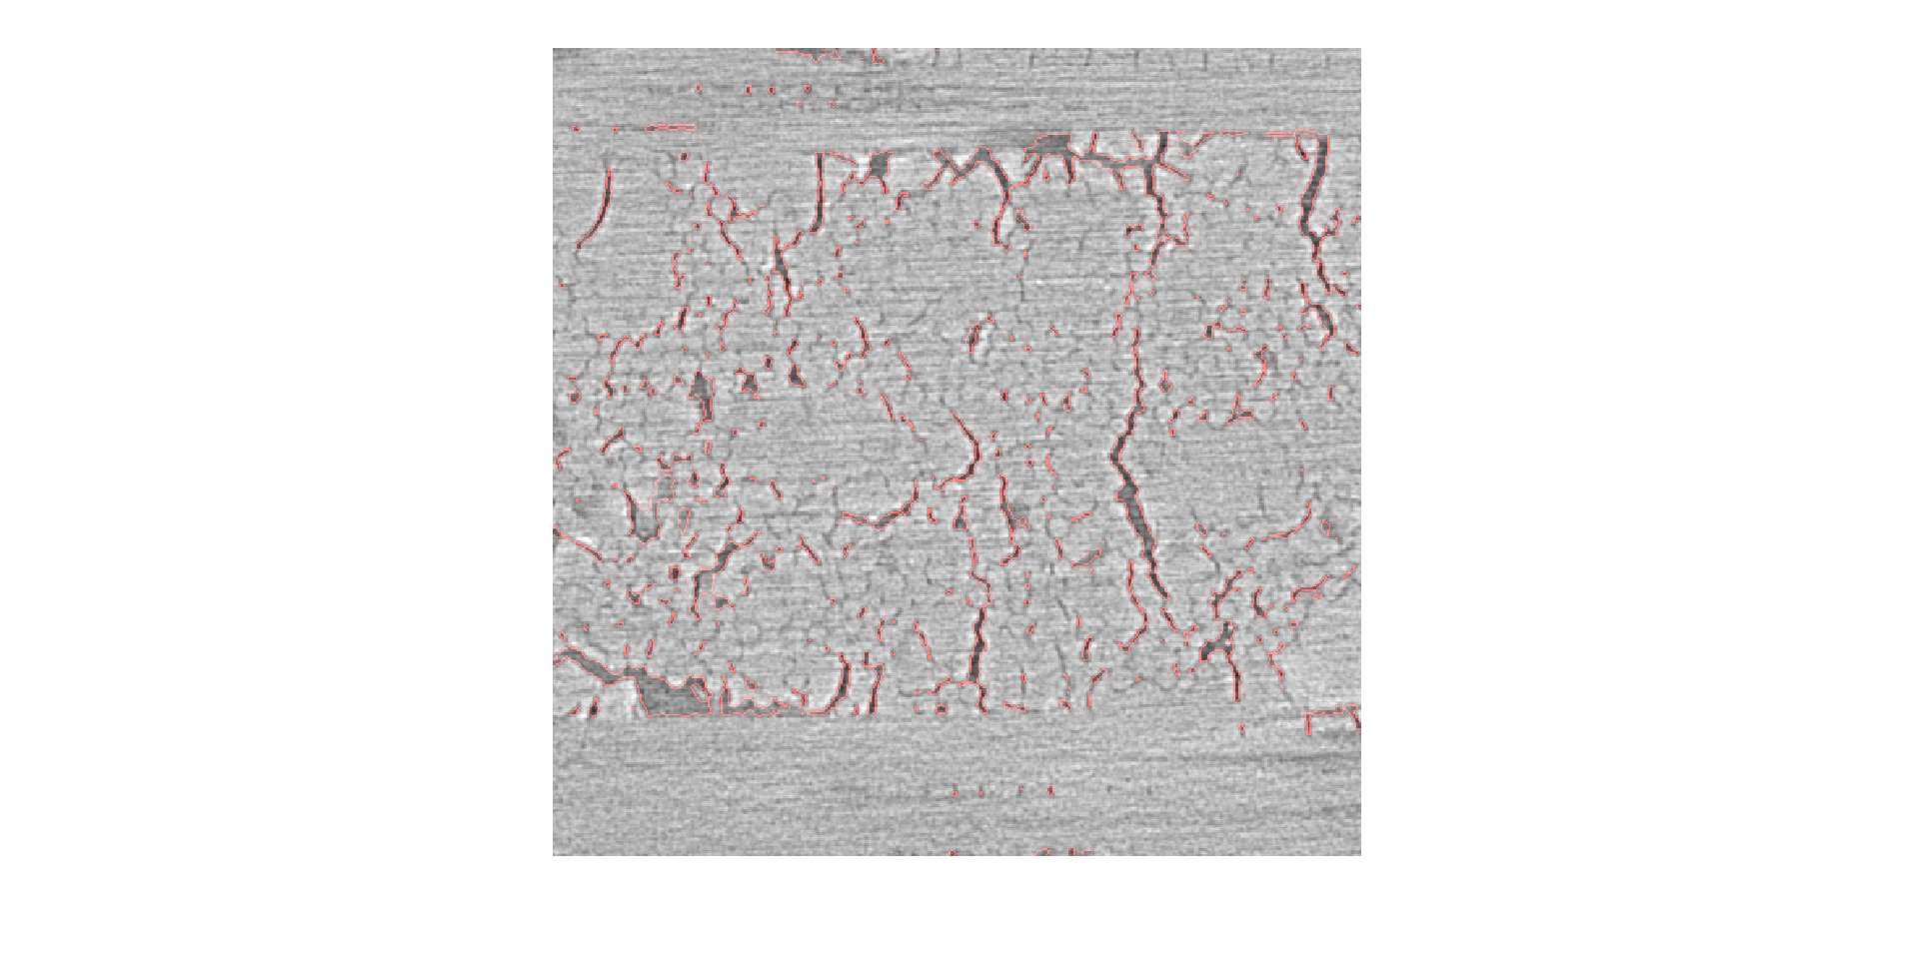
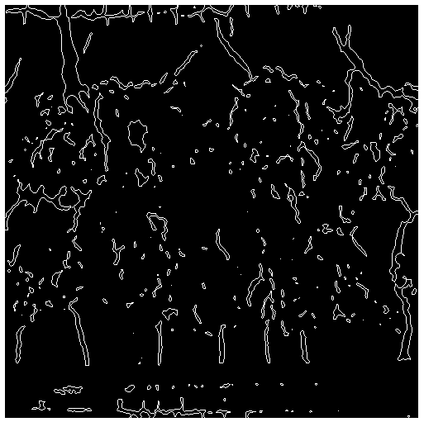
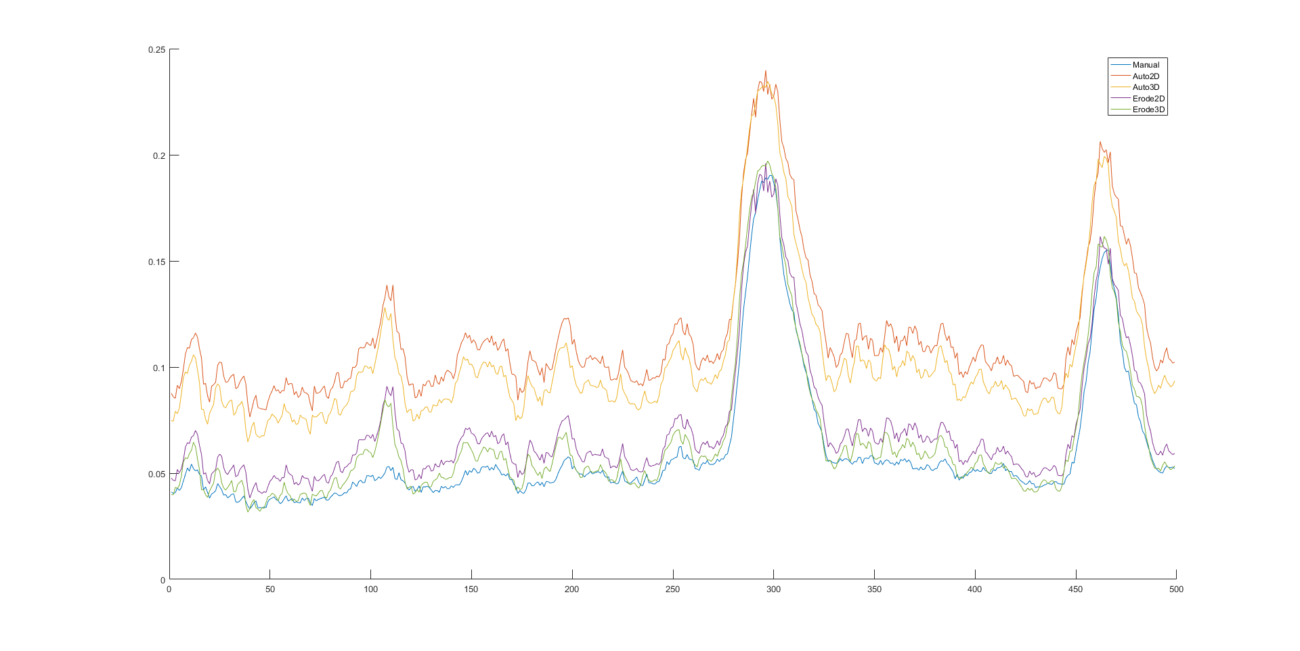
Results and discussion

Slide 13
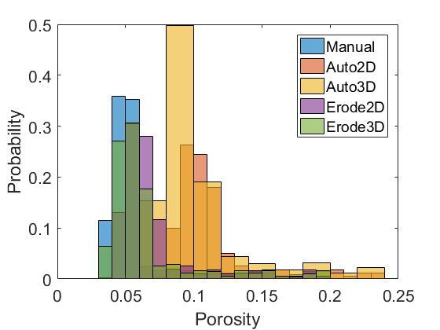
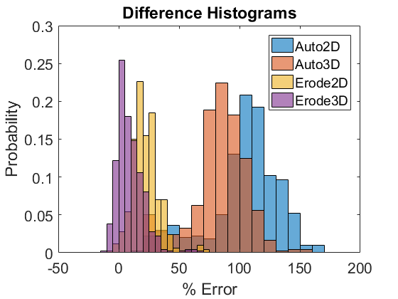
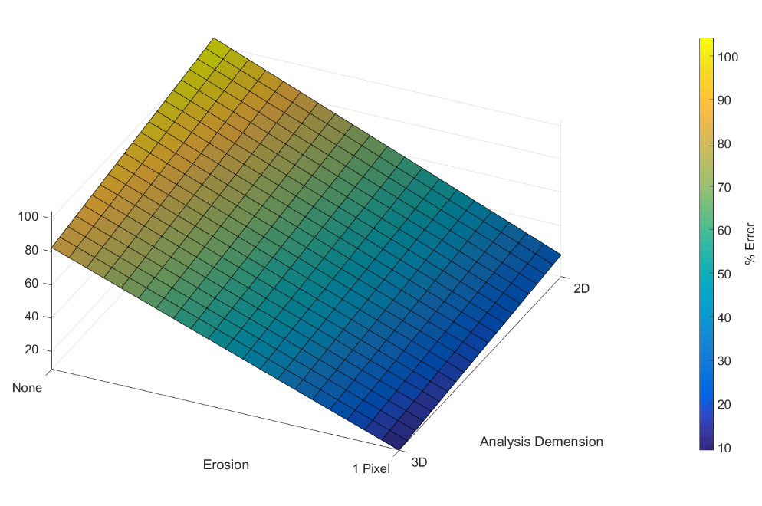
Results and discussion

Slide 14
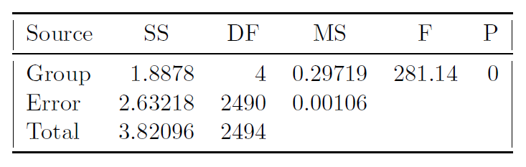
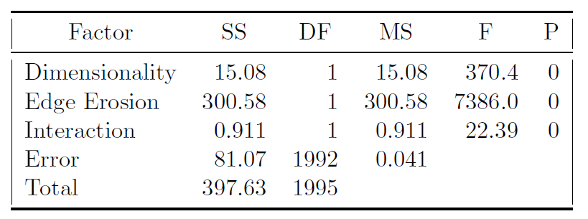
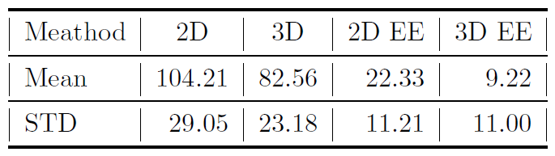
Results and discussion

Slide 15
Error/Variability Discussion
In 1-2 slides, analyze your data and calculations for the important assumptions/requirements for each statistical analysis tool that you used.
Provide some discussion of how your data’s compliance with the assumptions/requirements (or lack of compliance) might affect your results.
If you believe that your data may not have perfectly fit all of the assumptions/requirements, provide some suggestions of what you could do in the future to improve your data set so that the assumptions/requirements are better met.
If you made the decision to neglect or throw out any data from your population, provide a description here of what you did and why (using scientifically valid reasoning).

Slide 16
Error/Variability Discussion

Slide 17
Conclusions and Future Directions
Provide the main conclusions that you can determine from your project.
Make sure that the conclusions are framed in the context of your hypotheses.
Be sure to provide only the conclusions that can made with statistical analysis (e.g., “reject H₀, thus giving evidence in support of H_{A}”) and provide statistical support for each conclusion (e.g., p-values, linear regression coefficients)
In addition, provide some suggestions for future directions of the project.
If the project is part of your research, discuss what the next steps are in your research and how the results of your DoE project will affect that direction.
If the project is not part of your research, provide some suggestions of new directions that would be interesting to pursue.

Slide 18
Conclusions and Future Directions
Demonstrates the ability of an automatic segmentation algorithm to produce results with no statistically significant differences compared to manual segmentation.
Average error of less than 10\% was achieved.
Pixel erosion was shown to be an effective method to compensate for over-prediction of image porosity.
Future work will include additional testing on full-volume data sets.

Slide 19

Thank you!
Questions?

